Slide 1

SOEN 6431 SOFTWARE MAINTENANCE AND EVOLUTION
Dr. Juergen Rilling
Dynamic Slicing

Slide 2

Slicing classifications
Types of slices
Static
Dynamic
Direction of slicing
Backward
Forward
Executabiliy of slice
Executable
Closure
Levels of slices
Intraprocedural
Interprocedural
2

Slide 3
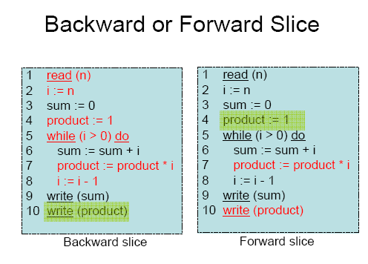
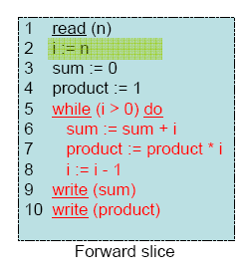
Static backward vs static forward slice

Slide 4
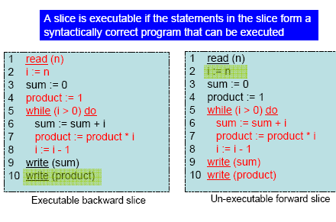
Executable vs. non-executable slice

Slide 5

What is the slice for S (a,8) ???
1. If (x) then
2. a=a+1;
3. Else
4. if (y)
5. a=a+10;
6. else
7. a=a-1;
8. cout << a;

Slide 6
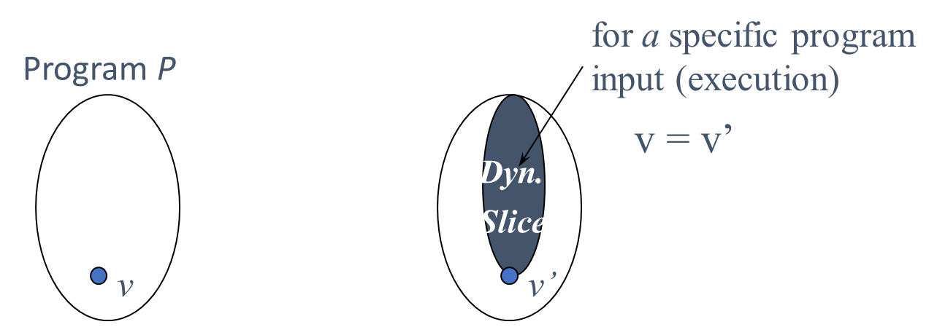
Dynamic Program Slicing
Dynamic slicing was originally introduced by Korel and Laski in 1988. A dynamic slice is an executable part of a program P whose behavior is identical, for the same program input, to that of the original program with respect to a variable v at some execution position.

Slide 7

Slicing Properties
Dynamic Slicing
Computed for a single input scenario
Deterministic instead of probabilistic
Useful for applications that are input driven (debugging, testing)
Slicing criterion <i, p, v>
7

Slide 8
Two Major Dynamic Slicing Categories
Execution trace-based algorithms:
Require first the recording of an execution trace and then compute a dynamic slice based on the recorded execution trace.
Non-Execution trace-based algorithms:
Compute the dynamic slice during run-time without requiring
any major recording of the program execution.

Slide 9
Program Execution Trace
Sample program:
1 input (n,a);
2 max := a[1];
3 min := a[1];
4 i := 2;
5 s:= 0;
6 while i ≤ n do
begin
7 if max < a[i] then
begin
8 max := a[i];
9 s := max;
end;
10 if min > a[i] then
begin
11 min := a[i];
12 s := min;
end;
13 output (s);
14 i := i +2;
end;
15 output (max);
16 output (min);
Execution trace for n=2 ,a =(1,2)
1¹ input (n,a);
2² max := a[1];
3³ min := a[1];
4⁴ i := 2;
5⁵ s := 0;
6⁶ i ≤ n
7⁷ max < a[i];
8⁸ max := a[i];
9⁹ s := max;
10¹⁰ min > a[i];
13¹¹ output(s);
14¹² i := i +2;
6¹³ i ≤ n
15¹⁴ output (max);
16¹⁵ output (min);

Slide 10

Backward Algorithm
Original dynamic slicing algorithm presented by Korel and Laski in 1988.
Based on a recorded execution trace for an input x.
Traces the execution trace backwards to derive dynamic data and control dependencies.
Create individual node in the PDG for each executed statement.
Execution trace-based Algorithms

Slide 11
Dynamic Dependency Graph
Algorithm:
Create a node for every statement executed.
Important: The number of nodes in your dependency graph will directly correspond to the nodes in your execution trace.
For each node in your dynamic dependency graph identify the last nearest last data and control dependency in the trace. Important: if a statement uses 2 variables there should be also exactly 2 data dependencies
To compute a dynamic backward slice: Traverse backwards all incoming edges from your point of interest (slicing criterion)
Important, For dynamic backward slicing, the slicing criterion is a triple S (variable of interest, node #, position in the execution trace)

Slide 12
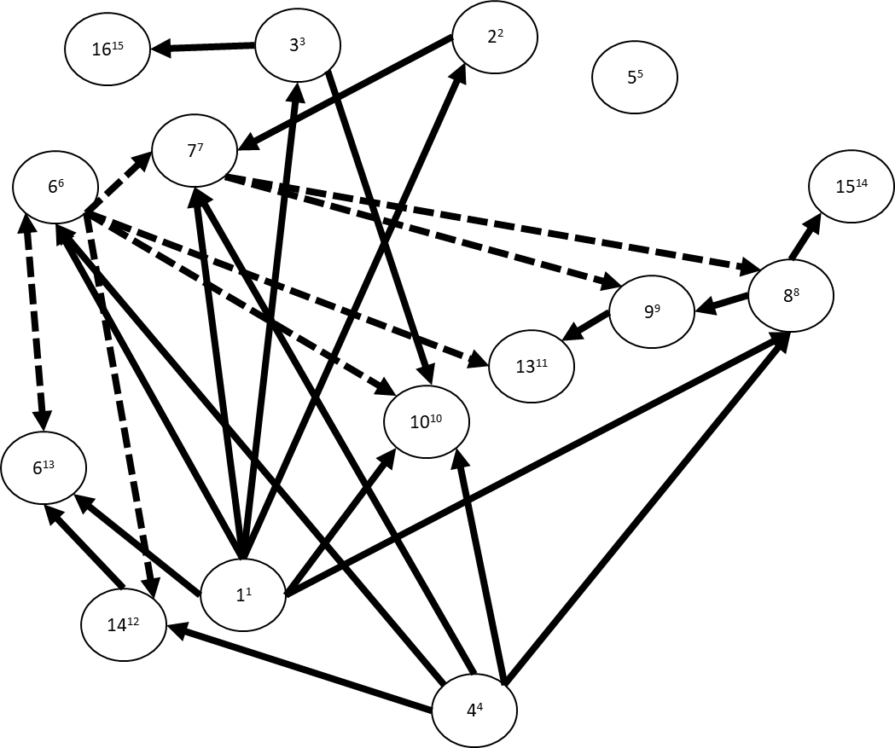
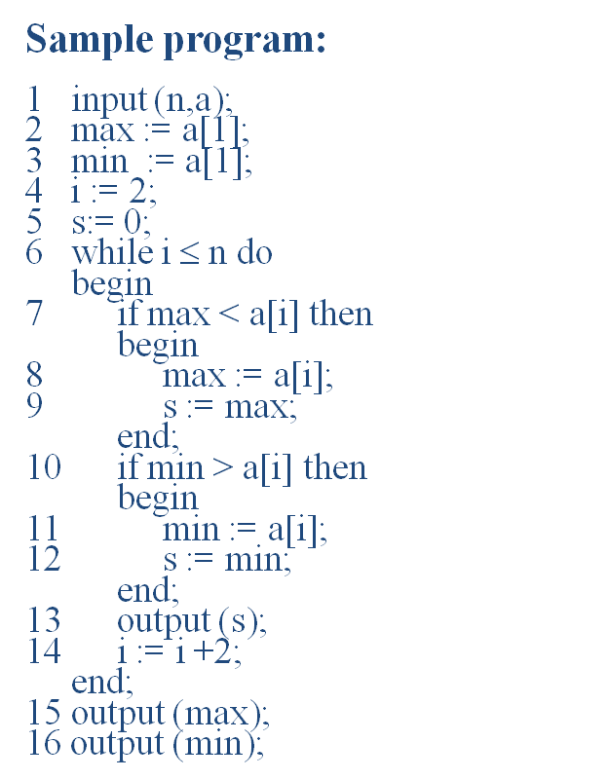
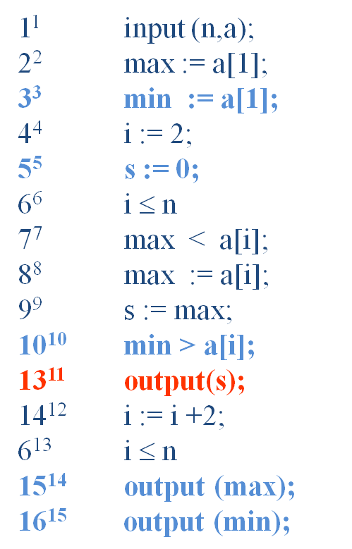
Backward Algorithm
Program Execution for n=2, a[1,2]

Slide 13
Static vs. Dynamic slice for variable s
Static Slice:
1 input (n,a);
2 max := a[1];
3 min := a[1];
4 i := 2;
5 s:= 0;
6 while i ≤ n do
begin
if max < a[i] then begin
8 max := a[i];
9 s := max;
end;
10 if min > a[i] then
begin
11 min := a[i];
12 s := min;
end;
13 output (s);
14 i := i +2;
end;
Dynamic Slice:
1 input (n,a);
2 max := a[1];
4 i := 2;
5 s:= 0;
6 while i ≤ n do
begin
7 if max < a[i] then
begin
8 max := a[i];
9 s := max;
end;
13 output (s);
14 i := i +2;
end;
Dynamic slice for variable s
on input n=2, a[1,2];

Slide 14
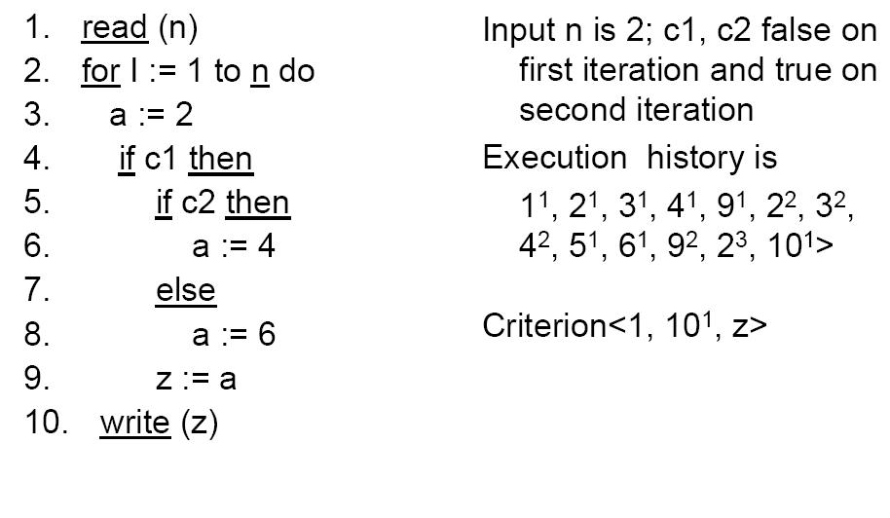
Another Dynamic Slice Example

Slide 15
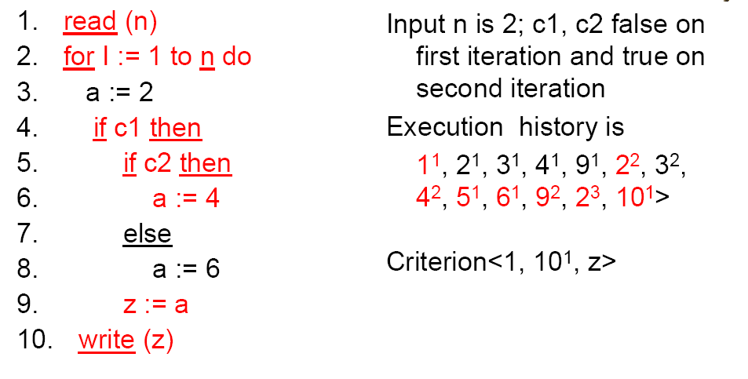
Another Dynamic Slice Example

Slide 16
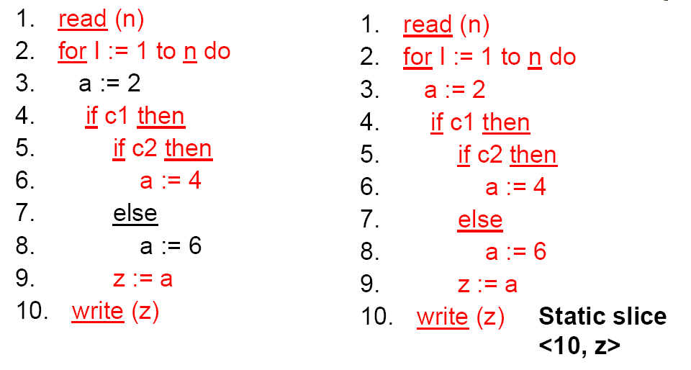
Static vs. Dynamic Slice

Slide 17

Any problems?
Q: How many nodes do we have in a Dynamic Dependency Graph?
A: ???
Q: How many dynamic slices can we compute?
A: ???
Q: Any suggestion on how to reduce the complexity?
A: ???

Slide 18
Challenge: Space complexity.
For I = 1 to 10000
for J = 1 to 10000
if (I>200000)
a= 4;
else
a = I+J;
Cout << a;
1,1
2,2
3,3
5,4
6,5
2,6
…

Slide 19
Dynamic Forward Slicing

Slide 20
Challenge: Complexity of Dynamic Slicing
A removable block is informally:
The smallest part of program text that can be removed during a slice computation without violating the syntactical correctness of the program, e.g.: loops, if/then/else, assignment-statements, goto-statements,and break statements.

Slide 21
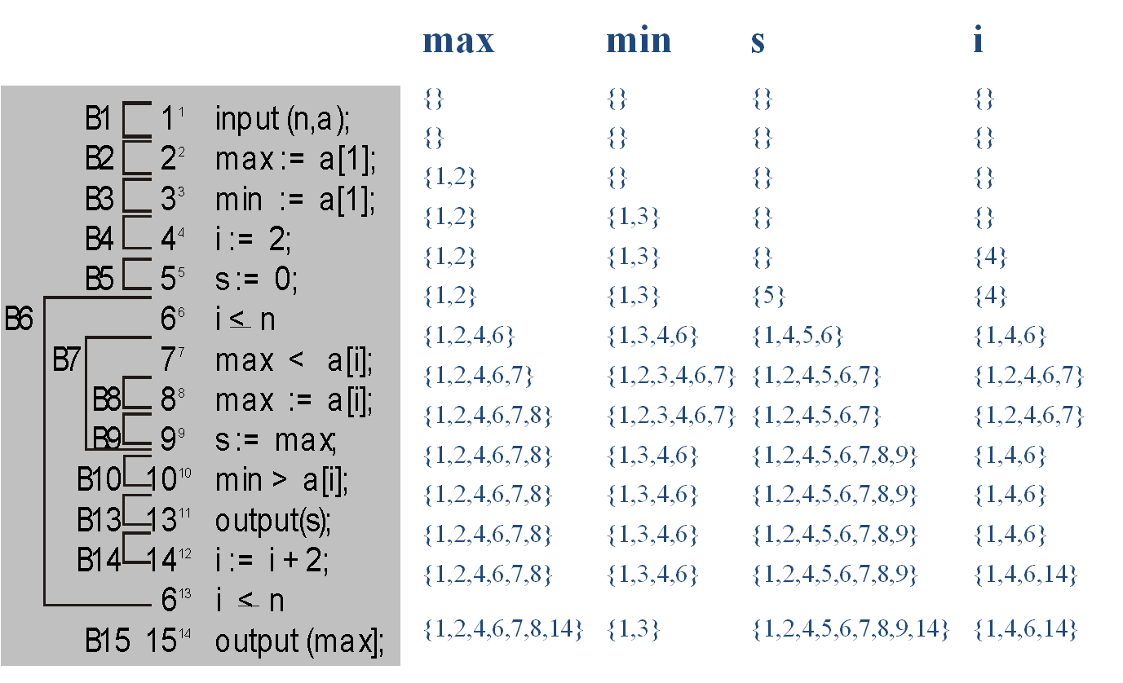
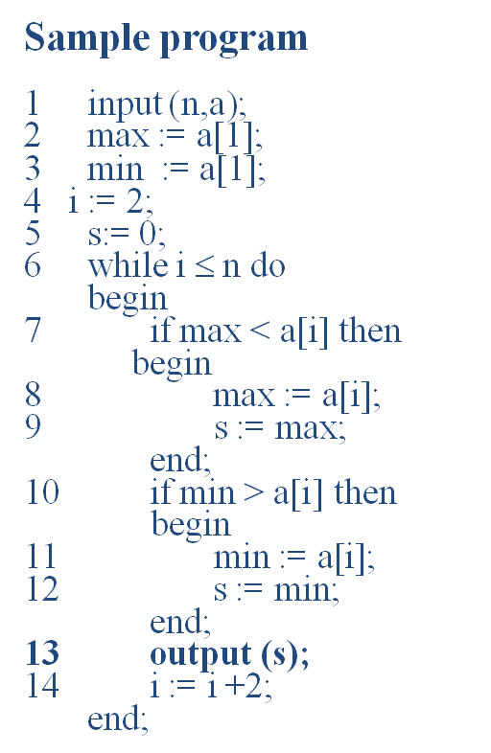
Sample program
21

Slide 23

Advanced Static Slicing

Slide 24

Challenges: Arrays, Records, and Pointers (mainly static slicing)
Arrays:
Simple approach: treat each array assignment as both definition and use. Problem: too conservative
To determine if use of a[g(j)] depends on definition of a[f(i)], we need to test whether f(i) can be equal to g(j)
Undecidable in general but can be solved for some expression types
The solutions are one sided: can determine if f(i) and g(j) cannot be equal, but no information otherwise
Records:
Easy: treat record.field as record_field
Pointers:
Hard: requires points-to analysis

Slide 25
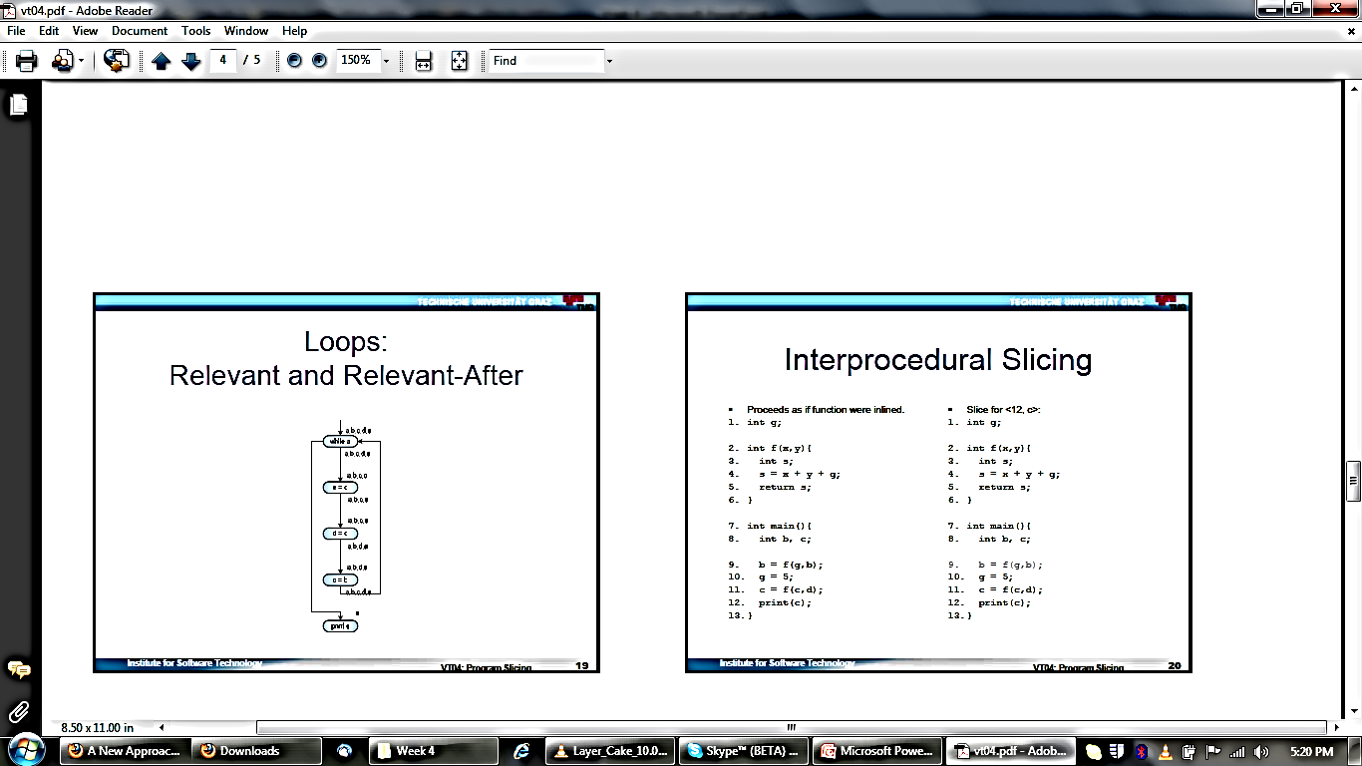

Slide 26
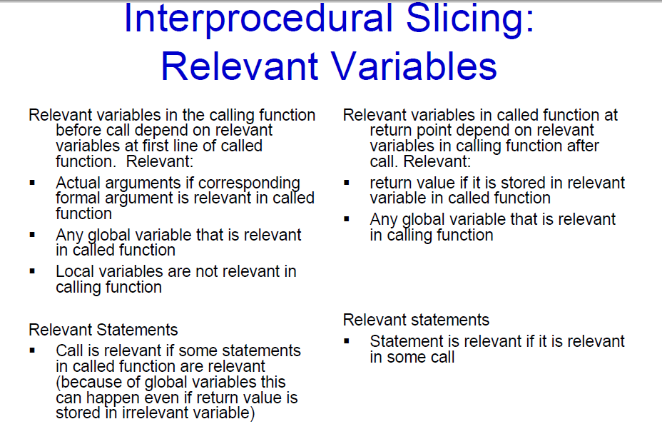

Slide 27
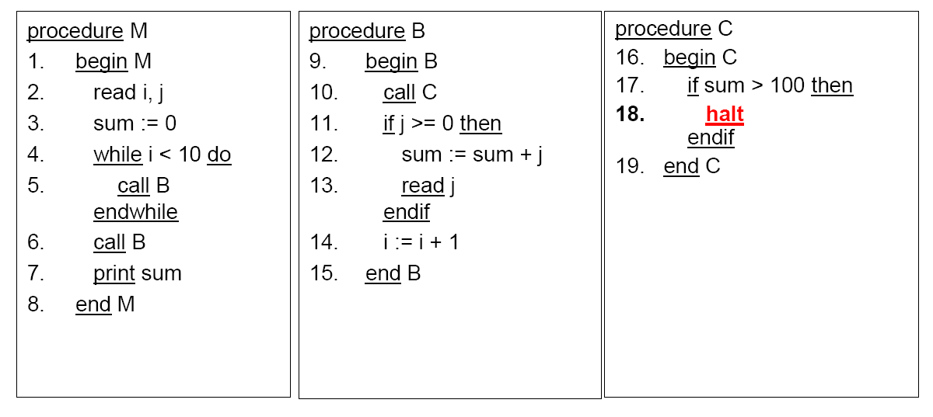
Example Procedural

Slide 28
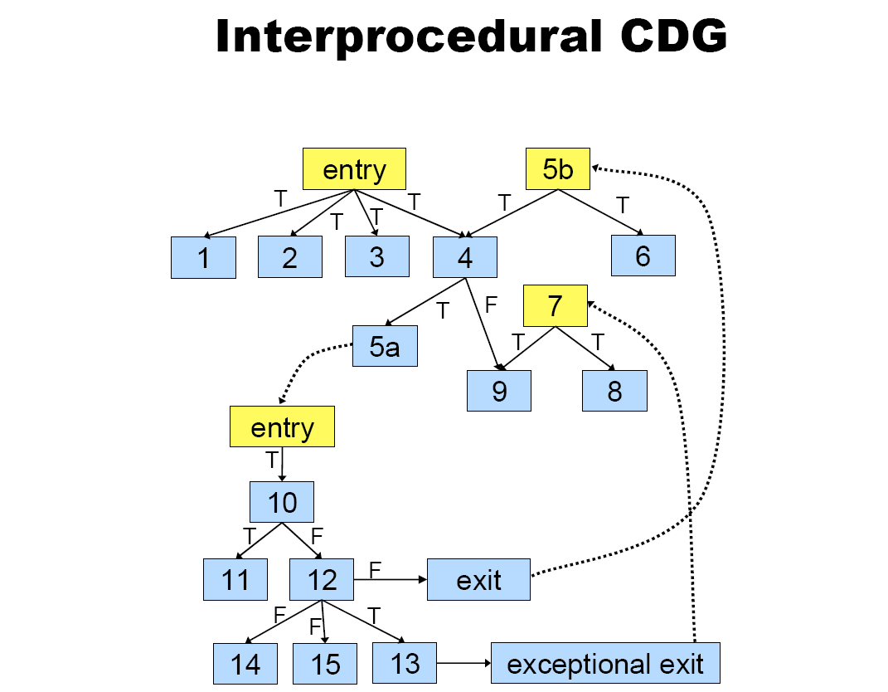

Slide 29
Challenges: Slicing unstructured programs
Explicit control transfer statements (goto, return, exit, break, continue) complicate the construction of control set
A conservative solution: if goto statement has a non-empty relevant set, include goto and its target in the slice
An alternative approach: look for labeled statements in the slice, then include goto statements that branch to these labels

Slide 30
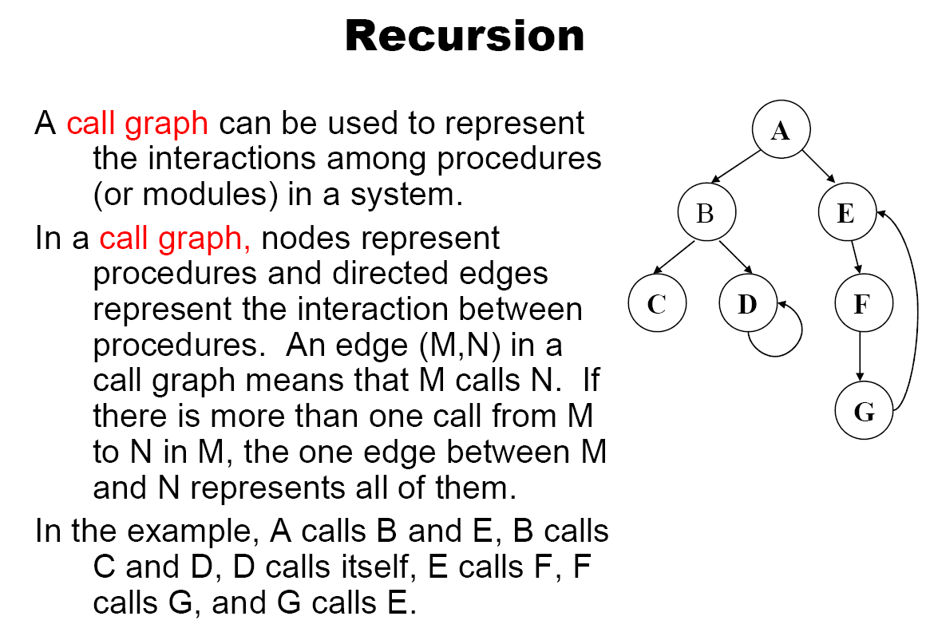

Slide 31
Other Extensions and challenges
Multi threaded programs
Multi language programs
Distributed programs
Very large systems
Libraries and Off the Shelf Components – no source code might be available

